Slide 1
Privacy Policy Inference of User Uploaded Images on Content Sharing Sites
Presented By: Project Guide:

Slide 2
ABSTRACT
In the proposed system, the system has implemented a two-level framework which according to the user’s available history on the site, determines the best available privacy policy for the user’s images being uploaded. Our solution relies on an image classification framework for image categories which may be associated with similar policies, and on a policy prediction algorithm to automatically generate a policy for each newly uploaded image, also according to users’ social features.
Over time, the generated policies will follow the evolution of users’ privacy attitude. We provide the results of our extensive evaluation over 5,000 policies, which demonstrate the effectiveness of our system, with prediction accuracies over 90 percent.

Slide 3
EXISTING SYSTEMS
EXISTING SYSTEM:
Most content sharing websites allow users to enter their privacy preferences. Unfortunately, recent studies have shown that users struggle to set up and maintain such privacy settings.
One of the main reasons provided is that given the amount of shared information this process can be tedious and error-prone. Therefore, many have acknowledged the need of policy recommendation systems which can assist users to easily and properly configure privacy settings.

Slide 4
DISADVANTAGES:
Sharing images within online content sharing sites,therefore,may quickly lead to unwanted disclosure and privacy violations.
Further, the persistent nature of online media makes it possible for other users to collect rich aggregated information about the owner of the published content and the subjects in the published content.
The aggregated information can result in unexpected exposure of one’s social environment and lead to abuse of one’s personal information.

Slide 5
PROPOSED SYSTEM
In this paper, the system proposes an Adaptive Privacy Policy Prediction (A3P) system which aims to provide users a hassle free privacy settings experience by automatically generating personalized policies. The A3P system handles user uploaded images, and factors in the following criteria that influence one’s privacy settings of images:
The impact of social environment and personal characteristics. Social context of users, such as their profile information and relationships with others may provide useful information regarding users’ privacy preferences. For example, users interested in photography may like to share their photos with other amateur photographers.

Slide 6
The role of image’s content and metadata. In general, similar images often incur similar privacy preferences, especially when people appear in the images. For example, one may upload several photos of his kids and specify that only his family members are allowed to see these photos.
ADVANTAGES:
The A3P-core focuses on analyzing each individual user’s own images and metadata, while the A3P-Social offers a community perspective of privacy setting recommendations for a user’s potential privacy improvement. We design the interaction flows between the two building blocks to balance the benefits from meeting personal characteristics and obtaining community advice.

Slide 7
SYSTEM SPECIFICATION
Hardware Requirements:
System : Pentium IV 3.4 GHz.
Hard Disk : 40 GB.
Monitor : 14’ Colour Monitor.
Mouse : Optical Mouse.
Ram : 1 GB.

Slide 8
Software Requirements:
Operating system : Windows Family.
Coding Language : J2EE (JSP, Servlet,Java Bean)
Data Base : MY Sql Server.
IDE : Eclipse Juno
Web Server : Tomcat 6.0

Slide 9
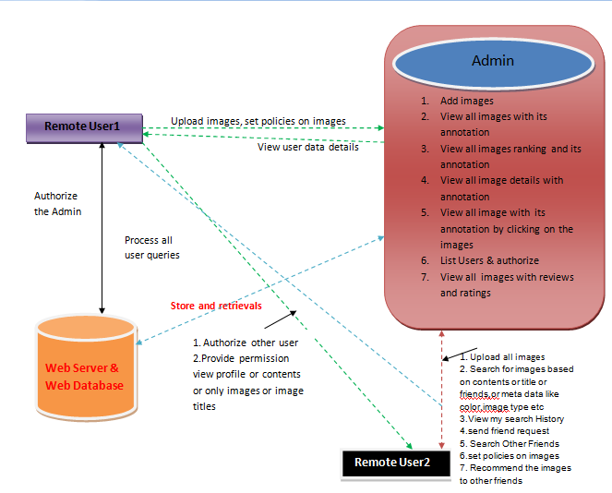

Slide 10
Implementation

Slide 11
System Admin
The system admin is responsible for providing authorization for a specified users and can do some operations such as view uploaded images, view the searching history, view all image ranking and view all users, search images and logout.

Slide 12
Upload Images
In this module, the user can upload n number of images by their policies If user want to upload new image then he has enter some fields like image name, image color, image description, image type, image usage, browse the image file and upload. After uploading successfully he will get a response from the server. Initially new uploaded image rank is zero. After viewing that image rank will re-rank.

Slide 13
End User
In this module, there are n numbers of users are present. User should register before doing some operations. And register user details are stored in user module. After registration successful he has to login by using authorized user name and password. Login successful he will do some operations like view my details, search images, request secrete key and logout.
The user click on my details link then the server will give response to the user with all details such as user name, phone no, address, e mail ID and location. Before searching any images user should request a authorization to admin, then the admin will provide an authorization for particular user and send to the user. After getting an authorization user can search the images base on query or keyword and field like image name, image color, image usage and image type. And server will give response to the user, then that image rank will be increased.

Slide 14
Content-Based Classification
To obtain groups of images that may be associated with similar privacy preferences, we propose a hierarchical image classification which classifies images first based on their contents and then refine each category into subcategories based on their metadata. Images that do not have metadata will be grouped only by content.
Such a hierarchical classification gives a higher priority to image content and minimizes the influence of missing tags. Note that it is possible that some images are included in multiple categories as long as they contain the typical content features or metadata of those categories.

Slide 15
Re-ranking chart
In this module, we can view the image ranking chart for all the images. This chart shows the ranking images in the form of PI diagram with the image name and image color. After viewing the images, rank will be increased and the re-ranking Pi diagram chart will increased based on the number of views.

